Slide 1
Solution to WS6

Slide 2
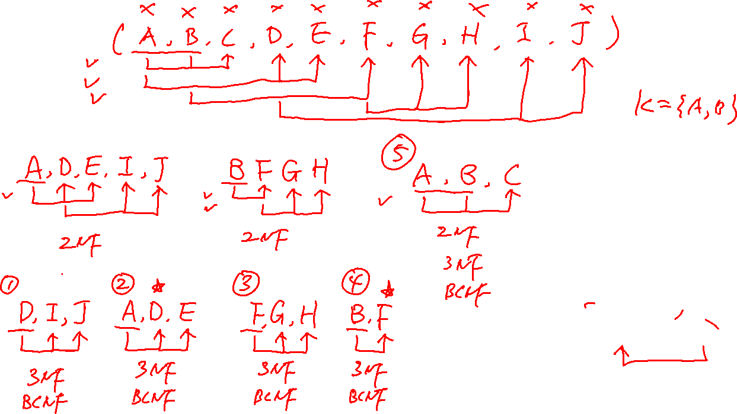

Slide 3
